Slide 1
HELCOM biodiversity, litter, underwater noise and effective regional measures for the Baltic Sea (HELCOM BLUES)
Final summary overview (25.01.2021-24.01.2023)

Slide 2
Grant information
Programme concerned: MARINE STRATEGY FRAMEWORK DIRECTIVE: SUPPORT TO THE PREPARATION OF THE NEXT 6-YEAR CYCLE OF IMPLEMENTATION
Reference number of the call for proposals: DG ENV/MSFD 2020 call
Grant agreement number: No. 110661/2020/839624/SUB/ENV.C.2
Title of the project: HELCOM biodiversity, litter, underwater noise and effective regional measures for the Baltic Sea (HELCOM BLUES)
Objective: The aim of HELCOM BLUES is to support regional capacity, coordination and cooperation with regards to developing effective measures to secure good status of the marine environment.
Consortium: 14 Partners & >7 subcontractors,
all from 6 out of 9 Baltic Sea states

Slide 3
Project Consortium
Project Partners
Project sub-contractors
Abbreviation | Full name
AAPC | Center for Environmental Policy | LT
HELCOM | Helsinki Commission | -
IfW | Kiel Institute for the World Economy | DE
LIAE | Latvian Institute of Aquatic Ecology | LV
LUKE | Natural Resources Institute Finland | FI
SLU | Swedish University of Agricultural Sciences | SE
SMHI | Swedish Meteorological and Hydrological Institute | SE
SU | Stockholm University | SE
SwAM | Swedish Agency for Marine and Water Management | SE
SYKE | Finnish environment institute | FI
TalTech | Tallinn University of Technology | EE
TiHo | University of Veterinary Medicine Hannover | DE
UHAM-CEN | Center for Earth System Research and Sustainability, University of Hamburg | DE
UT | University of Tartu | EE
Abbreviation | Full name
AKTiiVS | AKTiiVS Ltd. | LV
ICES | International Council for the Exploration of the Sea | -
GAR | GaviaEcoResearch | DE
QO | QuietOceans | -
MZ | Meereszoologie | DE
KST | Keep Sweden Tidy | SE
NRM | Swedish Natural History Museum | SE

Slide 4
Results summary – support effective regional measures (A1)
Task | Deliverables | Results
1.1 | Eveloping the assessment framework | Improved framework for sufficiency, effectiveness and economic impacts of measures done (e.g. Description, Spatial aspects, beneftis etc)
1.2 | Improved dat for the assessment | Data for assessing the effectiveness and costs of regionally coordinated actions collated, surveys done and data availble for analyses
1.3 | Estimation of benefits | Results of a literature review, Improved approach for assessing regional benefits, Regional benefit estimates of achieving GES
1.4.1 | Results on the use of marine waters | Report available aspart of the HOLAS 3 thematic assessment of ESA, Chapter 3
1.4.2 | Results for improved sufficiency and effectiveness of measures analysis | Review of previous work done and improvements identified. Methodology updated via task 1.1 and 1.2 for updating the model. Model code partially done.
1.4.3 | Results on the cost of degradation | Report available aspart of the HOLAS 3 thematic assessment of ESA, Chapter 4
1.4.4 | Review of state-of-the-art for regional cost-benefit analyses and develop cost data for one or more topics | Report available aspart of the HOLAS 3 thematic assessment of ESA, Chapter 6
1.4.5 | Description of incentives and regulations around the Baltic Sea countries to mitigate nutrient loading | Network overview and questionnaire with CP done. Report finished, with 2 additional paper

Slide 5
Key messages for effective regional measures (A1)
Key messages for science
Data(bases) for costs and benefits, should be used and further developed
SOM continuing to improve, but still requires development to realize management potential
Cost-effectiveness analysis should take into account the incentives to implement the intended set of measures
Key message for policy makers
Despite large value currently derived from the Baltic Sea, value can still be greatly increased through environmental improvement
To increase this value, coordination of Baltic Sea protection policies need to be maintained and intensified
Further improvement of UMW and CoD depends on data standardization and data development policies
Data sharing and data centralization for costs and effectiveness of environmental measures should be a high priority nationally and regionally

Slide 6
Results summary – bycatch (A2.1)
Task | Deliverables | Results
Subtask 2.1.1 | Further development of risk area mapping | Application of risk mapping method to 3 seal species and 11 waterbird species, allowing to identify some (species-specific) areas of high bycatch risk
Subtask 2.1.2 | Evaluating bycatch assessment approach developed in OSPAR-HELCOM bycatch WS | Indicator assessments for 6 marine mammal populations and 11 waterbird species, all showing that Good Environmental Status is not achieved
Key messages for science
1) Where applicable, bycatch assessments indicated negative impact on marine mammal &waterbird populations
2) More precise data of fishing effort and mammal/bird bycatch are needed to quantify the impact of bycatch on the population level
3) High-resolution bycatch assessments are required for development of targeted measures
Key messages for policy makers
1) Bycatch in fishing gear threatens the viability of marine mammal and waterbird populations in many parts of the BS
2) Bycatch monitoring needs to be implemented to allow identification of high risk areas and population effects as a basis for targeted management measures
3) Measures against bycatch must be taken to prevent deterioration of marine ecosystems

Slide 7
Results summary – fish (A2.2)
Task | Deliverable | Results
Subtask 2.2.1 | Improved assessment approach -foremost for coastal fish -also for species where ICES do not provide analytical reference points (flatfish species and three-spined stickleback) | ASCETS provides thresholds with associated uncertainty. Implemented in HOLAS 3 coastal fish indicators and flatfish stocks, implemented on three-spined stickleback
Subtask 2.2.2 | Development of a size-based assessment for the same species and communities | L90 operationalized. Implemented in HOLAS 3 with thresholds for coastal fish key species (perch), and HOLAS 3 flatfish stocks (trends over time)

Slide 8
Key messages for fish (A2.2)
Key messages for science
1) Improved methodology for analysing structural change in time-series including uncertainty
2) Improved functional understanding of spatial and temporal dynamics in coastal fish species and offshore data-limited stocks, including uncertainties in assessments
3) Improved understanding of spatial and temporal variation in size structure of fish in the Baltic Sea, and effects of human pressures (Östman et al. in review), with methodological sampling variation taken into account
Key message for policy makers
1) Improved and extended status assessment (species and areas) for coastal fish
2) Assessment of changes in state of offshore data-limited stocks lacking ICES analytical reference points
3) Management targets for size structure for coastal key fish species and trends over time in the size structure of data-limited offshore species
→ Towards a more holistic and quantitative assessment of fish in the Baltic Sea

Slide 9
Results summary – pelagic habitats (A2.3)
Task | Deliverables | Results
Subtask 2.3.1 | Complete operationalisation of the HELCOM Zooplankton Mean Size and Total Stock (MSTS) indicator | Operationalised in 10 sub-basins. The data availability hampers operationalisation in the remaining 7 sub-basins, particularly in the Southern areas.
Subtask 2.3.2 | Complete operationalisation of the HELCOM Seasonal succession of dominating phytoplankton groups indicator | Operationalised in 13 open sea sub-basins (from 7 tested in HOLAS II) and 13 coastal assessment units (from 6 tested in HOLAS II).
Subtask 2.3.3 | Develop an approach to combine the operationalised indicators | The approach is developed combining three biological indicators and two eutrophication indicators
Subtask 2.3.4 | Evaluation of unified pelagic habitat assessment approaches and development towards a viable assessment in the Baltic Sea | A pilot study is conducted using OSPAR indicator PH1/FW5 Plankton lifeforms in 3 subbasins

Slide 10
Key messages for pelagic habitats (A2.3)
for science
All plankton indicators suggests profound changes in the pelagic food web, characterised by shifts towards smaller body size of zooplankton, prevalence of cyanobacteria, increased biomass of diatoms and/or the autotrophic ciliate Mesodinium rubrum. The relative importance of anthropogenic pressures vs climate for these changes are not sufficiently understood.
Indicators based on growth and production are needed to understand the mechanisms behind the observed community changes.
Linking pelagic indicators to biochemical flows in the food web can provide a mechanistic understanding of their dynamics.
for policy makers
A better conceptualisation of good environmental status for pelagic habitat and its components in different subbasins of the Baltic Sea is needed for meaningful targets and policy requirements.
Integration of plankton-based indicators into the food web assessment (D4) is needed to have ecologically relevant targets.
Harmonization of assessment scales would facilitate integration of plankton indicators

Slide 11
Results summary - harbour porpoise (A2.4)
Task | Deliverables | Results
Subtask 2.4.1. | Improved harmonisation between HELCOM and OSPAR regarding indicators on abundance | Increased discussion between expert groups allowed for increased efficiency in indicator development and future assessments
Subtask 2.4.2. | Assessing trends in abundance for assessment of the Belt Sea population | While no significant trend was detected, there was some indication of a decline in abundance of the Belt Sea population over time
Subtask 2.4.3. | Expert-based qualitative assessment of Baltic Proper population | The Baltic Proper population of harbour porpoises does NOT achieve GES for both abundance and distribution.

Slide 12
Key messages for harbour porpoise (A2.4)
Key messages for science
1) Thresholds used for indicators should be population-specific, considering available data, population dynamics, historical data, and existing pressures.
2) Long-term datasets are needed to assess trends- the trend for the Belt Sea population was only able to be assessed with 4 data points over a short time period of 15 years, which is hard to put into context ecologically, as it does not cover three generations for the species.
3) Reviews of old newspapers can provide useful data for data-deficient species/populations
Key message for policy makers
1) Harmonisation between RSC should be encouraged, as it allows for increased expert support, and reduces analyses and development time for required indicators
2) A lack of a statistically significant trend does not mean that the population is in good status
3) The Baltic Proper population does not achieve GES, urgently needs an updated abundance estimate, and was historically distributed much wider than today

Slide 13
Results summary - BEAT/ food web (A2.5)
Task | Deliverable | Results
Subtask 2.5.1 | Further development of the BEAT tool | Integrated assessments for fish, waterbirds, marine mammals and the pelagic habitat → HOLAS 3
Subtask 2.5.2 | Exploratory work towards an assessment of food webs | Contributions to HOLAS 3 food web assessment
Key messages for science
1) Further indicator development needed to cover all biodiversity aspects and increase spatial coverage
2) Specific food web indicators needed, including energy flows and transfer efficiency
3) Indicator threshold setting an important aspect of integrated assessments
Key message for policy makers
1) Monitoring important as the foundation of the assessments
2) Streamlining assessments across policies advantageous
3) Ecosystem-based management need to include food web aspects

Slide 14
Results summary - beach litter (A3.1)
Task | Deliverables | Results
Subtask 3.1.1 | Translation of historical litter data | Evaluation and harmonisation of different protocols was carried out (e.g., clustering of categories) and used as basis for assessment
Subtask 3.1.2 | Execute assessment of beach litter | First-time quantitative assessment of beach litter for the Baltic Sea, contributions to HOLAS 3 thematic assessment
Key messages for science and policy makers
Further work on harmonisation of beach litter protocols is key
Better geographical coverage with improving monitoring efforts to evaluate the effect of actions against marine litter is important
More attention is needed to how the subbasins assessments are influenced by types of included monitoring beaches, e.g. remote vs urban/semi-urban beaches
More research on identifying sources of litter is needed
Resources are needed for expanded monitoring programmes and research on sources and impacts
Further work on actions against marine litter is required to reach good environmental status in the Baltic Sea

Slide 15
Results summary – microlitter (A3.2)
Task / Subtask | Expected results and deliverable | Results
Subtask 3.2.1 | Review / evaluation of current approaches applied for the water column and seabed sediment | Compiled information for all HELCOM countries updated and available
Subtask 3.2.2 | Drafting of guidelines for the detection of microlitter in the water column and seabed sediments | Accomplished and included in the HELCOM Guidelines
Subtask 3.2.3 | Data collection from HELCOM countries on microlitter in the water column and seabed sediments | Lack of comparable data identified
Subtask 3.2.4 | Specification of prerequisites for the monitoring of microlitter in the water column and seabed sediments | Major hindrances identified and draft document suggested
Subtask 3.2.5 | Screening study on microlitter in the water column (LV) and seabed sediments (DE) | Guidelines validated. Data on microlitter in seabed sediments (DE) available

Slide 16
Key messages for microlitter (A3.2)
Key messages for science
1) There is still need for further discussions especially in terms of the selection of monitoring stations, the precision on QA/QC measures within sample processing and the data reporting.
2) There is still a lack of research findings concerning spatial and temporal representativeness of the monitoring strategy.
3) Data from the screening study on microlitter in seabed sediments indicate decreasing concentrations with increasing distance to the coastline.
Key message for policy makers
1) Major hindrances for microlitter monitoring are mostly related to logistics and resources that have to be solved for a consistent HELCOM wide monitoring and the generation of baseline and threshold values.
2) Cooperation between countries in terms of monitoring sampling campaigns and laboratory analyses should be further evaluated.
3) Additional efforts have to be made to support scientific approaches to assess the representativeness of data.

Slide 17
Results summary - continuous noise (A4.1)
Task | Deliverable | Results
Subtask 4.1.1 | Production of new soundscape maps | New soundscape maps produced and can be found on the ICES website
Subtask 4.1.2 | Develop and execute assessment on noise sensitive species | TV developed in alignment with TG noise processes, and first-time assessment carried out (indicator report)
Subtask 4.1.3 | Improve calibration standards for monitoring of continuous noise | Online workshop was held
Key messages for science
We need to know more about the effects of continuous noise on marine species
Better GES criteria should be elaborated based on improved knowledge on the effects of continuous noise
Key messages for policy makers
1) Low-frequency ship traffic noise can have adverse effects on fish
2) Care should be taken to avoid disturbance on known spawning grounds

Slide 18
Results summary - impulsive noise (A4.2)
Task | Deliverable | Results
Subtask 4.2.1 | Improve register for events | Improved version of reporting format and changes implemented
Subtask 4.2.2 | Develop and execute assessment method | First-time assessment carried out and aligned to TG noise processes, indicator report for HOLAS 3
Key messages for science
1) Effects of impulsive noise on other species than porpoise need further study
2) Further improvement of the assessment method required
Key message for policy makers
1) Reporting to the ICES impulsive noise registry has to be improved
2) Legislation regarding impulsive noise producing activities should be developed and harmonized for HELCOM countries
3) Moving forward urgent: new offshore wind developments on the way
Notes:
18

Slide 19
Use of results so far and in future
HELCOM Development and update of (pre-)core indicators, results used in HELCOM HOLAS 3 Thematic Assessments (Biodiversity, ESA, and Pollution)
BSAP action B8, B33, B15, B33, B34, B35, HL32, S48, S59, S62, S63, HT15, HT18
MSFD Article 8 status reporting on D1C1; D1C2, D1C3, D1C4, D1C6, D3C2, D3C3, D4C2, D10, D11C1, D11C2 ; support for monitoring programmes, Art. 13
Other relevant processes EU processes, EU Action Plan, ASCOBANS, AEWA, JRC pelagic habitat, TG Litter, TG Noise, RAP Noise, developed approached also for other marine areas, Research on various topics, Data exchange (EMODnet, HELCOM biodiversity database)

Slide 20
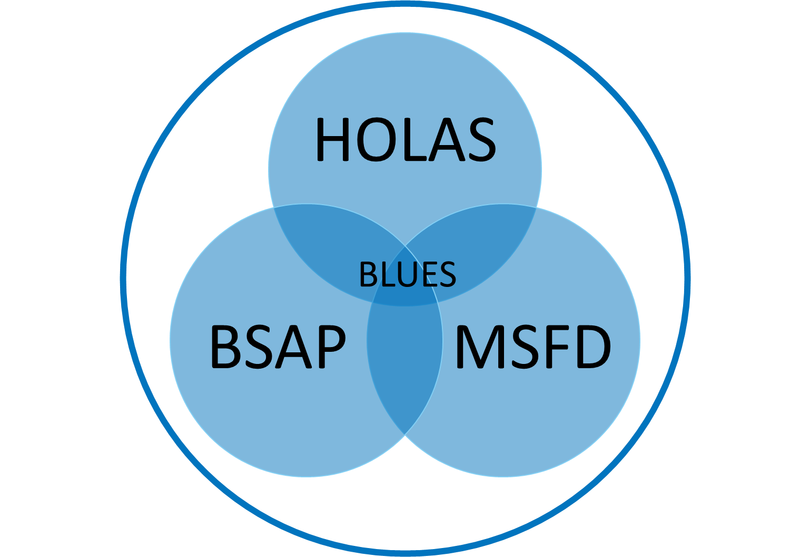
BLUES: supporting the decision-making process
Guides future decision making:
Where do we have areas in poor state?
What is causing the poor state?
Where should we target our measures, what measures should we choose and what activities do we need to manage?
Provides decision makers and authorities with:
Information on the status of the environment, specifically bycatch, pelagic habitats, food webs, harbour porpoise and non-commercial fish
Informs on the distribution of pressures (underwater noise and marine litter)
Information on human activities and their effects, society and economic aspect
Information on the spatial variation of status.
Information trends in development over time.
Follow up on the effect of measures.
BLUES as a platform for coordinating development
Benefitting from the expertise of others;
Sharing of knowledge, information and resources
Improved effectiveness, regional coherence, synergistic actions
Good state of the marine environment

Slide 21
Output summary – as of March 2023
47 documents for final reporting (42 pdf, 3 excel files, 1 media package, 1 model package)
6 newly developed (pre-)core indicators for biodiversity, marine litter and underwater noise (2 harbour porpoise; 1 coastal fish size; 2 underwater noise; 1 beach litter)
2 approved monitoring guidelines for microlitter (sea bed and water column)
5 further advanced indicators (1 bycatch; 2 coastal fish (species and groups); 1 zooplankton; 1 phytoplankton)
New developed indicator website
Test cases for food webs and pelagic habitats in the Baltic Sea (first time)
Improved methodology for various indicators, BEAT, economic and social analyses
Input to various chapters of the HOLAS 3 thematic assessment reports for ESA, biodiversity, and pollution
1 new expert group at HELCOM (EG FOODWEB)
Bonus output: Socioeconomic assessment of the Baltic Sea marine ecosystem services for assessing well-being impacts of marine protection and management policies (Pakalniete et al. 2023)
6 project videos (2 on HELCOM BLUES; 3 on central themes (i.e. indicators, ESA, and holistic assessments); 1 final project video)
Project website with all material (project overview on activities and partners; videos; media pack; brochure; interviews; news; final conference material)
Several dozen of workshops/meetings/IC sessions to give input, guide and approve the process
Scientific publications (3 published, 3 manuscripts, many more in preparation)
Coding done (e.g. on BEAT and SOM)
Data flows/reporting improved
Sharing knowledge with regional and European colleagues, e.g. via sister projects and TG groups (and various other meetings)

Slide 22
Thank you very much for your interest and support!
Contacts at HELCOM:
Project manager: Jannica Haldin Project coordinator: Jana Wolf

